Slide 1
K-Map
Digital Logic Design

Slide 2
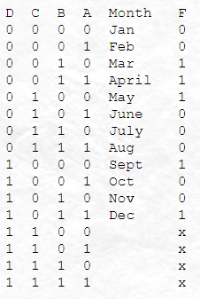
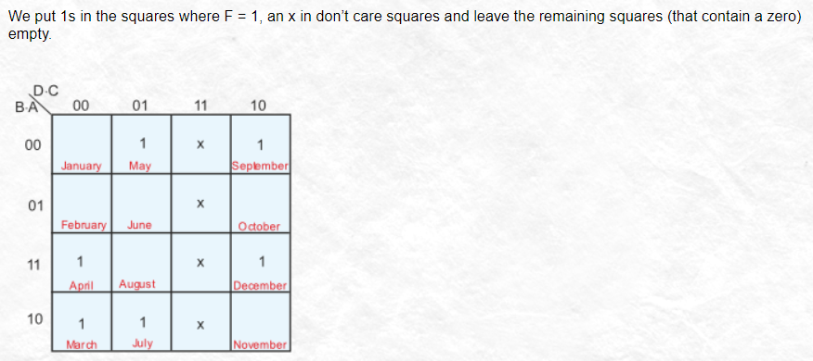
Don’t care Condition Examples

Slide 3
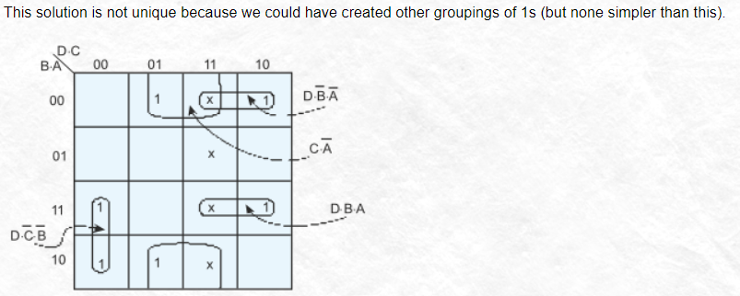
Don’t care Condition Examples (cont.)

Slide 4
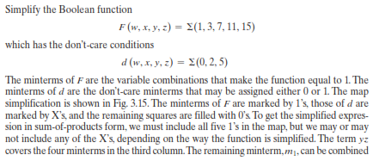
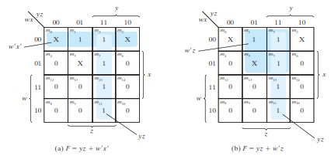
Don’t care Condition Examples (cont.)

Slide 5
Class task (Time 5 Mints)
F(A, B, C, D) = POS(6, 7, 8, 9) and d(12, 13, 14, 15)

Slide 6
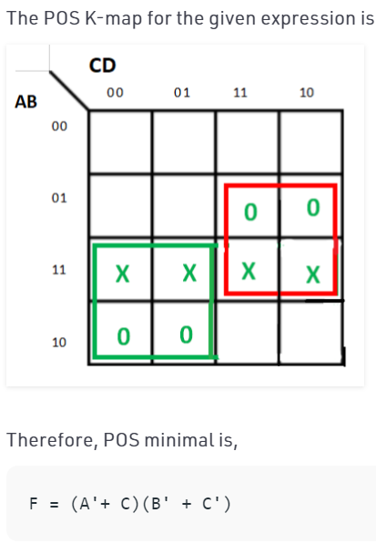
Class Task Solution

Slide 7
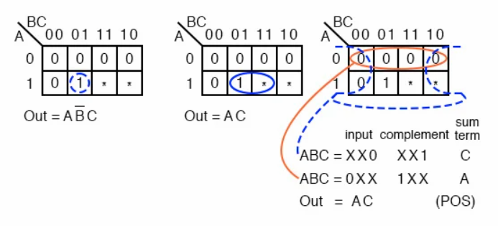
3 variable don’t care

Slide 8
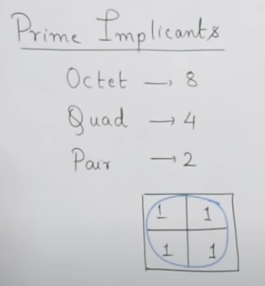
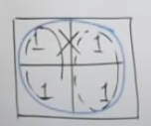
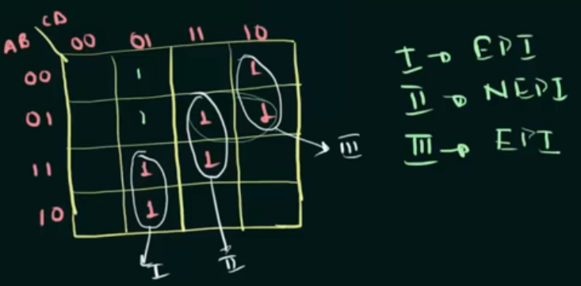
Prime implicants

Slide 9
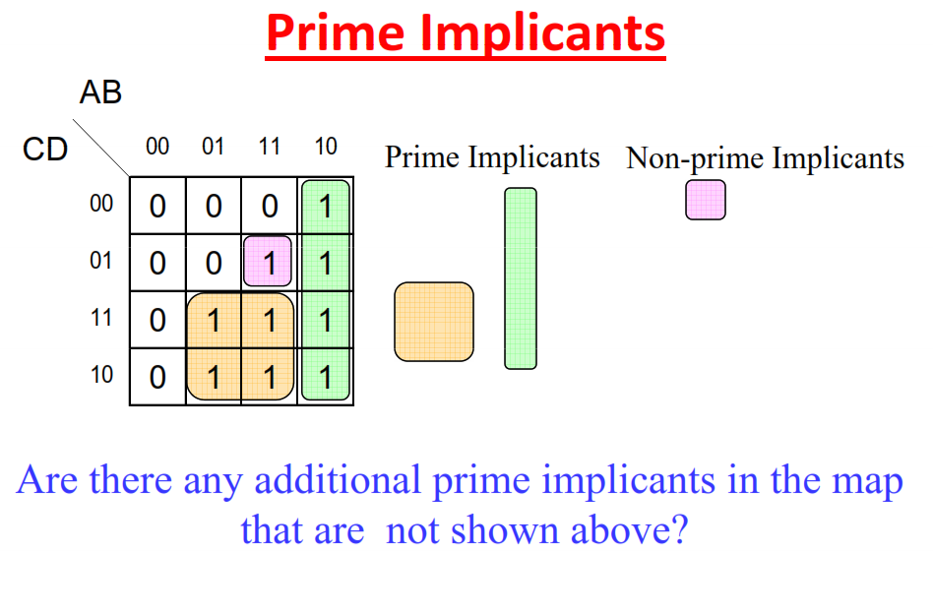
Prime implicants (cont.)

Slide 10
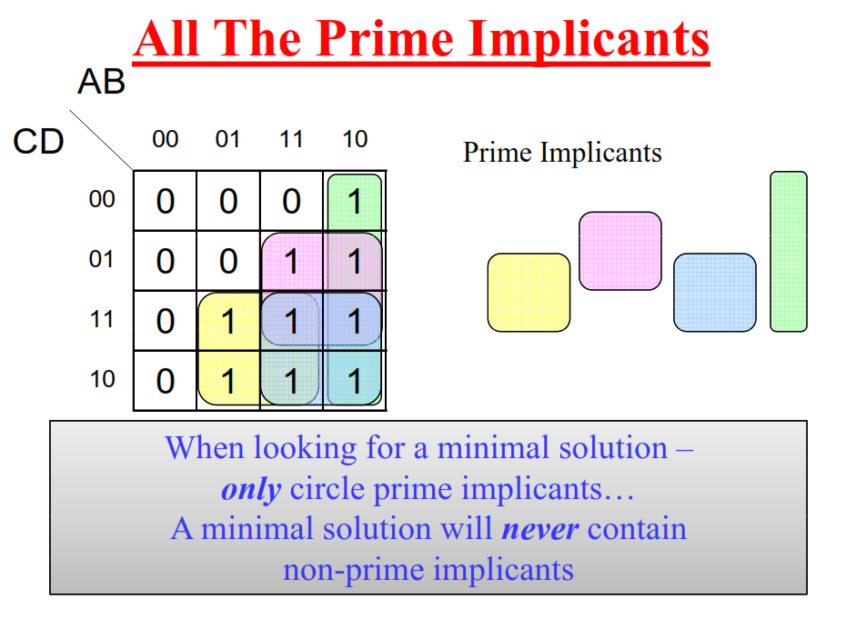

Slide 11
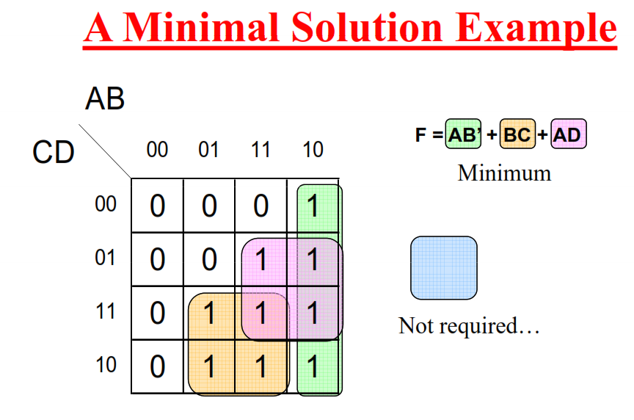
Prime implicants (cont.)

Slide 12
Two level implementation
AB+CD
AB’+A’B
AB+C+BC
(A+B)(C+D)
(A+B).C.(B+C+D)
((A+B+C).(B+C’))

Slide 13
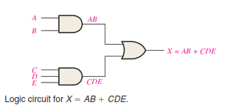
Two level implementation (cont.)

Slide 14
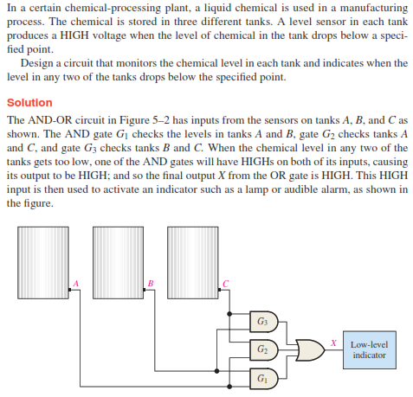
Two level implementation (cont.)

